Slide 1
Capstone:
Movie Rental Analysis
Power BI dashboard - using the Sakila DVD Rental Store Database

Slide 2
Dataset Explanation:
Dataset is a comprehensive collection of information from a movie rental service, encompassing a wide array of tables with details on actors, films, customers, rental transactions, & more. This rich dataset forms the foundation of my analysis, supplying insights into customer behaviour, film inventory management, & operations.
Table Explanations:
Actor Table: The actor table lists information for all the actors.
Actor id (Primary Key): A unique identifier for each actor.
first name: The first name of the actor.
last name: The last name of the actor.
Address Table: The address table has address information for customers, staff.
Address id (Primary Key): A unique identifier for each address.
address: The street address.
address2: Additional address information, if available.
district: The district or area.
City id (Foreign Key): A reference to the city table, standing for the city where the address is present.
Postal code: The postal code.
phone: The phone number associated with the address.
Category Table: The category table lists the categories that can assigned to films.
Category-id (Primary Key): A unique identifier for each category.
name: The name of the category.

Slide 3
City Table: The city table holds a list of cities.
City-id (Primary Key): A unique identifier for each city.
city: The name of the city.
Country id (Foreign Key): A reference to the Country table, standing for the country or region where the city is present.
Country Table: The country table holds a list of countries or regions.
Country-id (Primary Key): A unique identifier for each country.
country: The name of the country or region.
Customer Table: The customer table holds a list of all customers.
Customer id (Primary Key): A unique identifier for each customer.
Store id (Foreign Key): A reference to the Store table, showing the store where the customer registered.
First name: The first name of the customer.
last name: The last name of the customer.
email: The customer's email address.
Address id (Foreign Key): A reference to the Address table, specifying the customer's address.
active: A flag showing whether the customer's account is active.
Create date: The date when the customers created account.

Slide 4
Film Table: The film table lists all the films that may be in stock in the store.
Film id (Primary Key): A unique identifier for each film.
title: The title of the film.
description: A brief description of the film.
Release year: The year when the film released.
Language id (Foreign Key): A reference to the Language table, specifying the film's language.
Original language id (Foreign Key): A reference to the Language table, standing for the original language of the film.
Rental duration: The rental duration of the film.
Rental rate: The rental rate for the film.
Replacement cost: The cost to replace the film.
rating: The film's content rating.
Film text Table: The content of the film text table kept in synchrony with the film table by triggers on the film table INSERT, UPDATE, and DELETE operations.
Film id (Foreign Key): A reference to the Film table, with film title.
film title: The title of the film.
description: A brief description of the film.
Film actor Table: The film actor table support many to many relationships’ films and actors.
Actor id (Foreign Key): A reference to the Actor table, stands for the actor associated with the film.
Film id (Foreign Key): A reference to the Film table, showing the film in which, the actor appeared.

Slide 5
Film category Table: The film category table support many to many relationships between films and categories.
Film id (Foreign Key): A reference to the Film table, specifying the film associated with a category.
Category id (Foreign Key): A reference to the Category table, showing the category assigned to the film.
Inventory Table: The inventory table is a copy of a given film in each store.
Inventory id (Primary Key): A unique identifier for each inventory item.
Film id (Foreign Key): A reference to the Film table, stands for the film in the inventory.
Store id (Foreign Key): A reference to the Store table, showing the store where the inventory item is.
last update: The date and time when the inventory item updated.
Language Table: The table lists all values for the film & original language.
Language id (Primary Key): A unique identifier for each language.
name: The name of the language.
Payment Table: The payment table records every payment made by the customer, including information such as the amount and rent paid.
Payment id (Primary Key): A unique identifier for each payment transaction.
Customer id (Foreign Key): A reference to the Customer table, specifying the customer who made the payment.
Staff id (Foreign Key): A reference to the Staff table, showing the staff member who processed the payment.
Rental id (Foreign Key): A reference to the Rental table, standing for the rental associated with the payment.
amount: The payment amount.
Payment date: The date and time when of the payment.

Slide 6
Rental Table: The rental table holds a row for each rental of each inventory item, which holds information about who rented what, when it rented it, and when it returned.
Rental id (Primary Key): A unique identifier for each rental transaction.
Rental date: The date and time when the movie rented.
Inventory id (Foreign Key): A reference to the Inventory table, showing the inventory item rented.
Customer id (Foreign Key): A reference to the Customer table, specifying the customer who rented the film.
Return date: The date and time when the rental returned.
Staff id (Foreign Key): A reference to the Staff table, standing for the staff member who processed the rental.
Staff Table: The staff table lists all staff information, including email addresses, login information, and pictures.
Staff id (Primary Key): A unique identifier for each staff member.
first name: The first name of the staff member.
last name: The last name of the staff member.
Address id (Foreign Key): A reference to the Address table, specifying the staff member's address.
email: The email address of the staff member.
Store id (Foreign Key): A reference to the Store table, showing the store where the staff member works.
active: A flag showing whether the staff member is currently active.
username: The staff member's username for system login.
password: The staff member's password for system login.
last update: The date and time of the staff member's last update.
Store Table: The store table lists all stores in the system.
Store id (Primary Key): A unique identifier for each store.
Manager staff id (Foreign Key): A reference to the Staff table, standing for the staff member who manages the store.
Address id (Foreign Key): A reference to the Address table, specifying the store's address.

Slide 7
Valuable Insights: The Power BI dashboard built using the Sakila Movie Rental Database provides clear insights into rental performance, customer behavior, and film popularity. It highlights key patterns in revenue, category demand, language preferences, and customer engagement. These analytics help the business identify top-performing films, high-value customer groups, and strong operational areas.
Improvement Focus: The dashboard uncovers several opportunities for improvement, including optimizing film inventory, addressing low-performing categories, and improving customer retention. It also identifies mismatches between film availability and rental demand, enabling the business to refine its collection, improve stock distribution across stores, and tailor marketing to customer interests.
Evaluation of Effectiveness: By analyzing metrics such as on-time returns, rental duration, customer satisfaction proxies, and staff workload, the dashboard supports evaluation of operational efficiency. It helps measure how staff performance affects customer experience, how film ratings impact revenue, and how language availability influences rental frequency—enabling data-driven decisions that strengthen overall business performance.
CUSTOMER BEHAVIOR INSIGHTS
GEOGRAPHIC ANALYSIS
FILM PERFORMANCE EXAMINATION

Slide 8
ACTOR (STAR POWER) ANALYSIS
Trend Identification: Historical rental data reveals seasonal demand peaks, monthly fluctuations, and shifting customer preferences across film categories and languages. The dashboard highlights fast-moving vs. slow-moving films, emerging genres, and changes in rental behavior over time. These trends help improve forecasting, inventory planning, and campaign design.
Comprehensive Understanding: The dashboard provides a holistic view of the movie rental ecosystem by integrating insights from customers, films, rentals, payments, staff, and stores into a single platform. This unified perspective enables stakeholders to make informed, coordinated decisions that enhance customer satisfaction, reduce inefficiencies, and increase profitability across the entire rental business.
REVENUE OVERVIEW
RENTAL BEHAVIOR ANALYSIS

Slide 9
Objectives:
Data Exploration and Understanding: Project's primary aim is to thoroughly explore and understand the dataset derived from the movie rental industry. I aim to gain insights into the data's structure, relationships, and potential areas for analysis.
Customer Segmentation and Profiling: I intend to segment customers based on their rental behaviors, preferences, and demographics. By creating customer profiles, I offer targeted marketing strategies and personalized recommendations.
Film Performance Analysis: This project looks to analyse the performance of films within the rental store. This includes finding top-performing films, assessing their popularity, and recommending strategies for buying or promoting films to perfect revenue.
Staff Productivity Assessment: An important aim is to assess the productivity and performance of staff members. I aim to find high-performing employees, pinpoint areas for improvement, and recommend staff training or incentive programs.
Store Operations Efficiency: The project strives to enhance the overall efficiency of store operations. By analysing operational data, I find bottlenecks, streamline processes, and improve store revenue while keeping or reducing costs.
Data Visualization and Storytelling: I aim to create informative and engaging data visualizations using Power BI to effectively communicate my findings. These visualizations should tell a compelling data-driven story that is easy for stakeholders to understand.
Informed Decision-Making: My overarching aim is to provide rental store owners and decision-makers with the insights and recommendations needed to make informed decisions. I want to empower them with the tools to drive success in the competitive movie rental market.

Slide 10
Significance:
Data-Driven Decision-Making: In an era where data plays a vital role in shaping business strategies, this project empowers rental store owners and stakeholders with the tools and insights needed for data-driven decision-making. By analyzing customer behavior, perfecting film inventory, enhancing staff performance, and streamlining store operations, this project enables informed choices that have a direct impact on business success.
Customer-Centric Approach: Understanding customer behavior is at the heart of the project's significance. By segmenting customers, personalizing marketing strategies, and improving customer satisfaction, contribute to a customer-centric approach that can enhance loyalty and drive revenue growth.
Efficiency and Cost Reduction: This project addresses the need for efficiency and cost reduction by perfecting film inventory and store operations. Finding top-performing films, streamlining operational processes, and reducing unnecessary costs, contribute to improved profitability and sustainability for rental stores.
Competitive Advantage: In a highly competitive market, the project provides rental store owners with a competitive advantage. Through data insights, recommended marketing strategies, and staff performance enhancements, project equips businesses with the means to outperform competitors and excel in the industry.
Data Quality and Reliability: Ensuring data quality and reliability is paramount in project. By performing data cleaning and validation, I not only improve the quality of the analysis but also set a standard for the integrity of data in the industry. This has far-reaching implications for other businesses and data-driven ventures.
Transparency and Reproducibility: This project embraces transparency and reproducibility by documenting the entire process and methods. This approach sets a precedent for projects in various domains, emphasizing the importance of open and transparent data analysis practices.
Knowledge Transfer and Education: The insights and recommendations generated by project serve as valuable educational resources. They can use to educate stakeholders, staff, and the wider industry on the benefits of data analysis and data-driven decision-making.

Slide 11
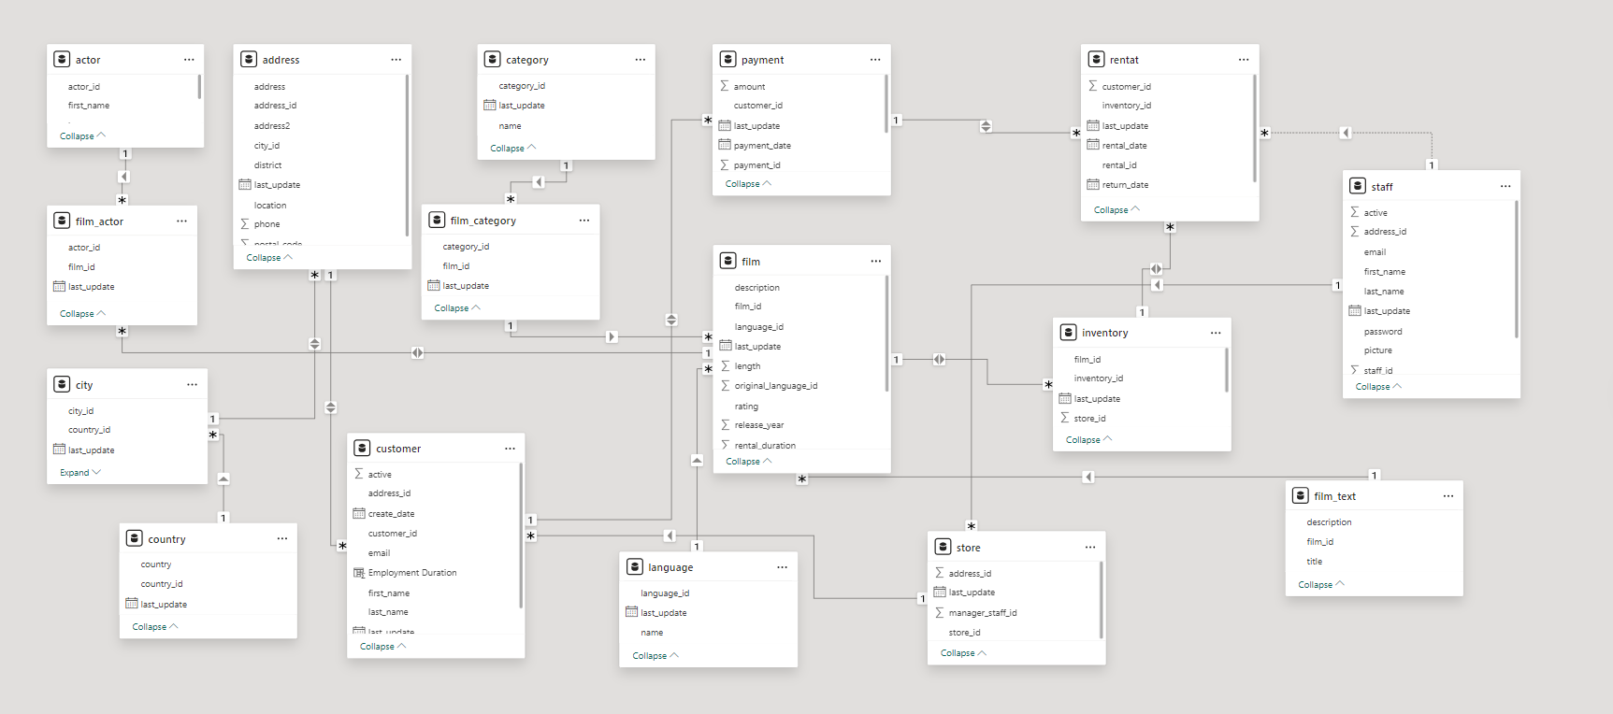
ER DIAGRAM

Slide 12
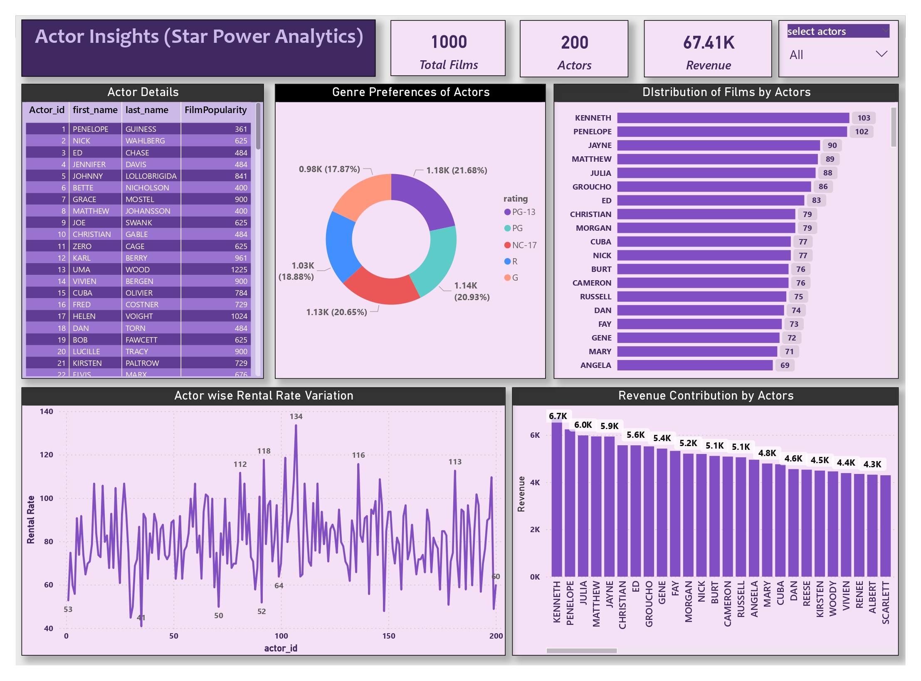

Slide 13
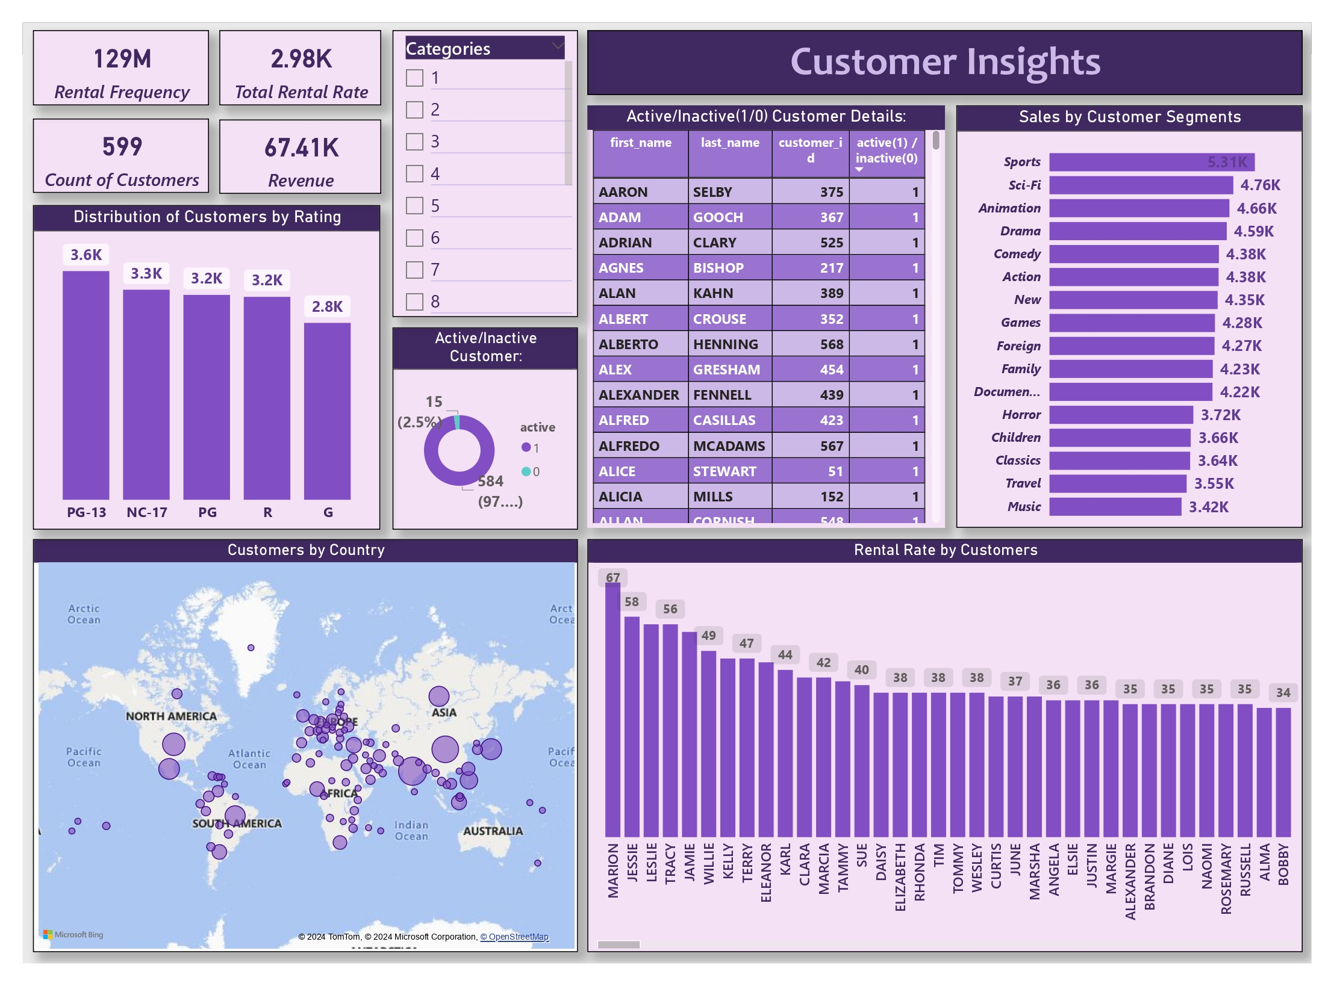

Slide 14
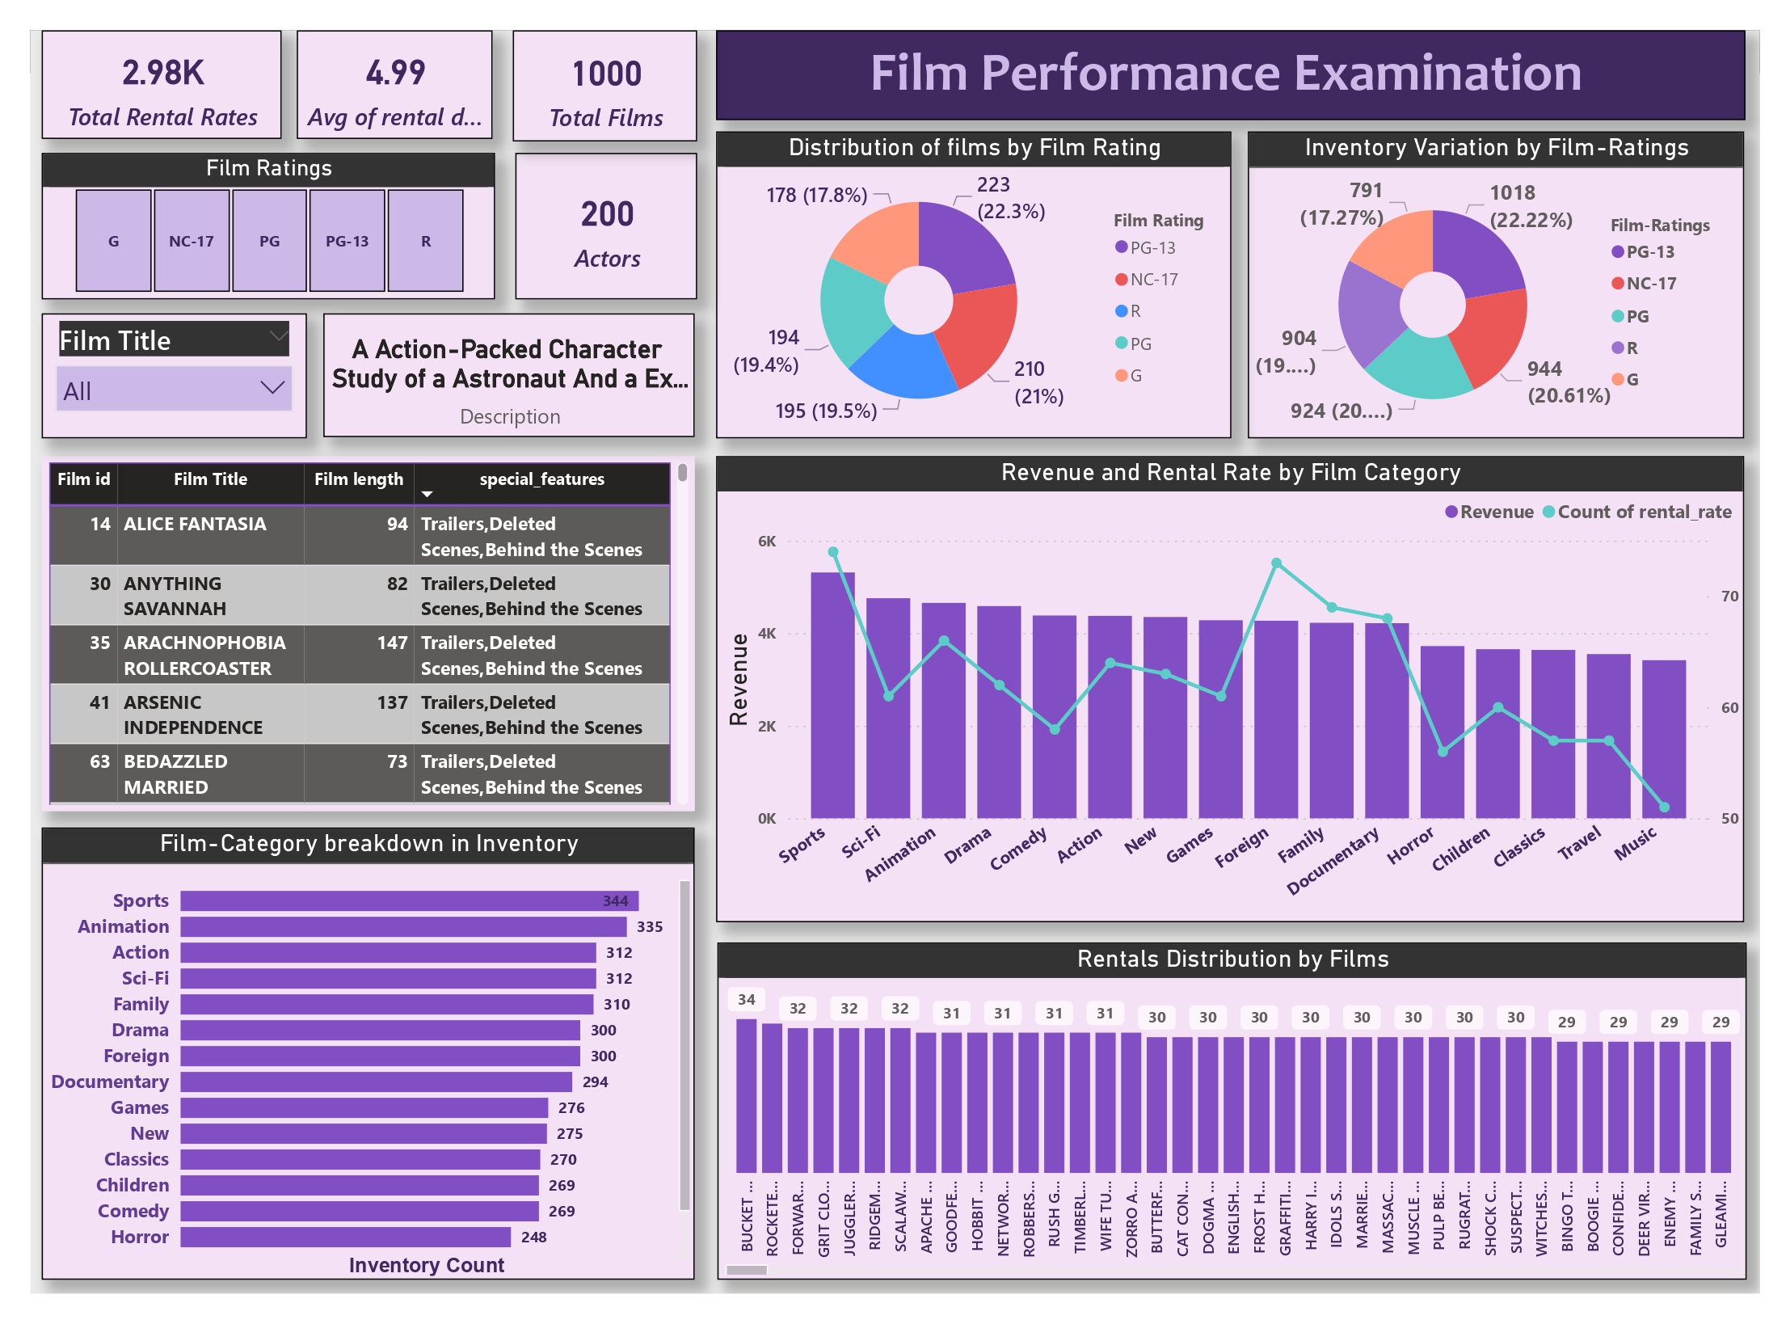

Slide 15
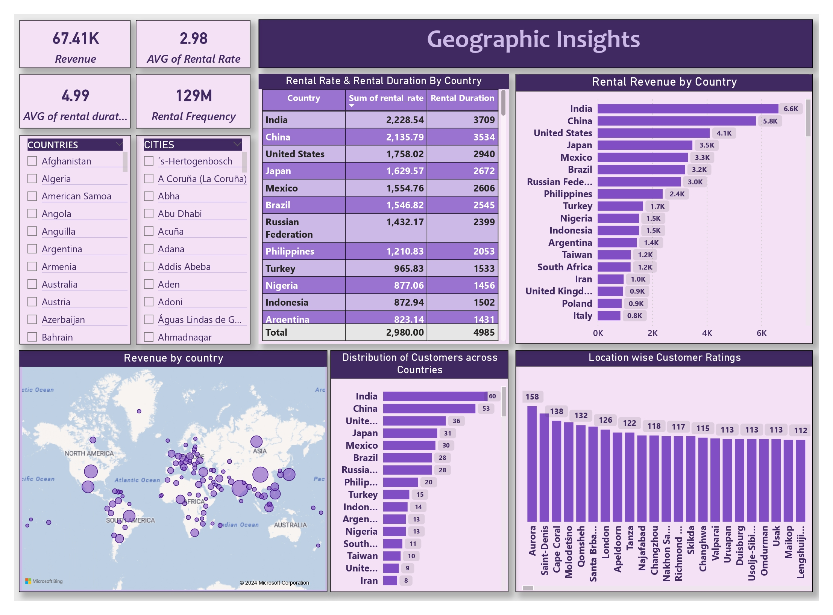

Slide 16
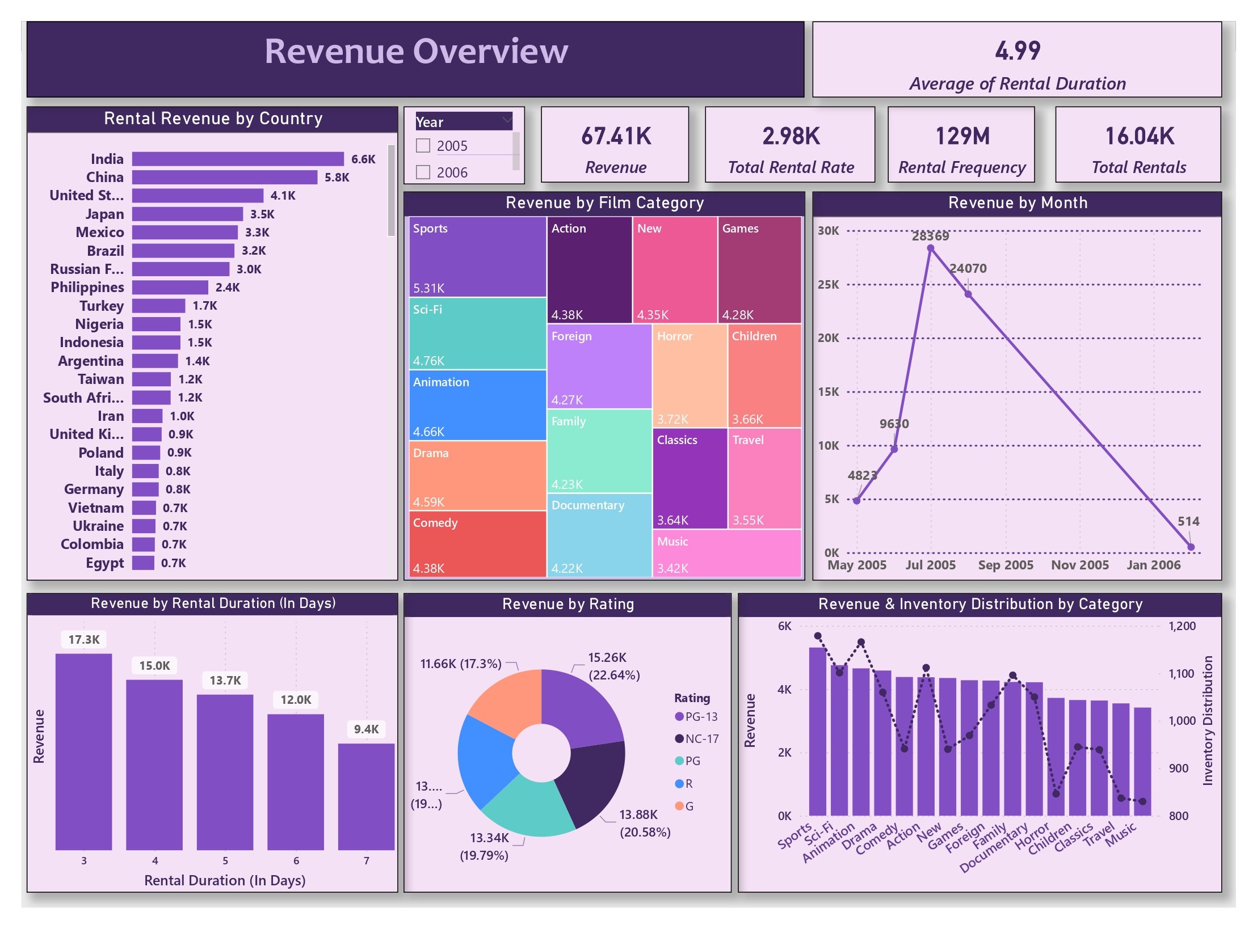

Slide 17
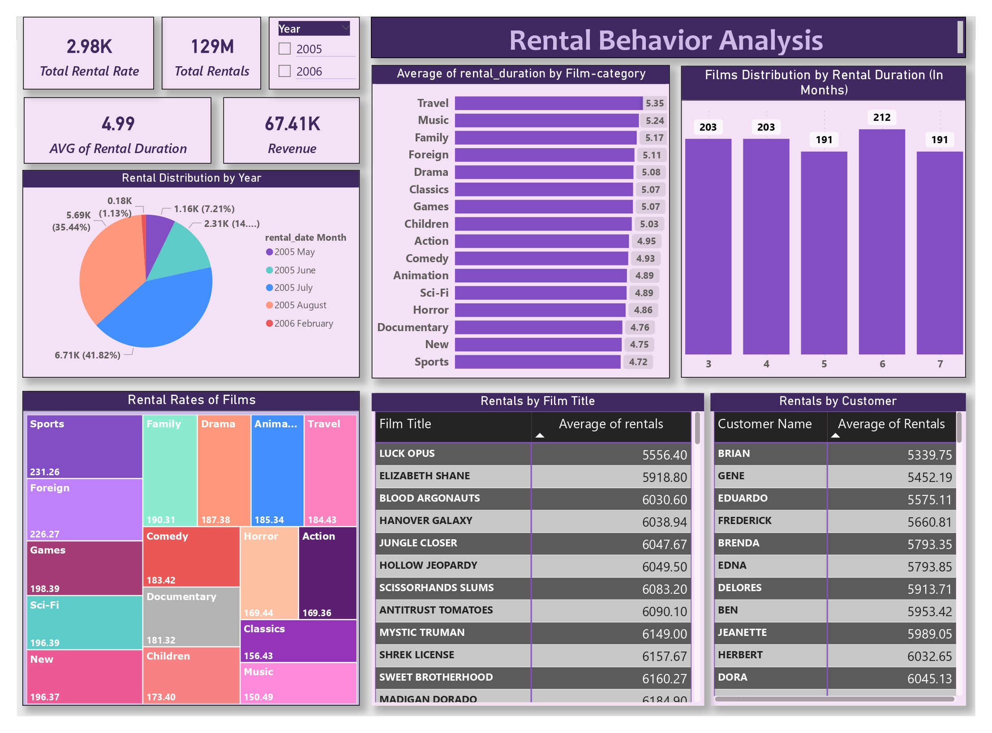

Slide 18

Power BI Problem
Statements

Slide 19
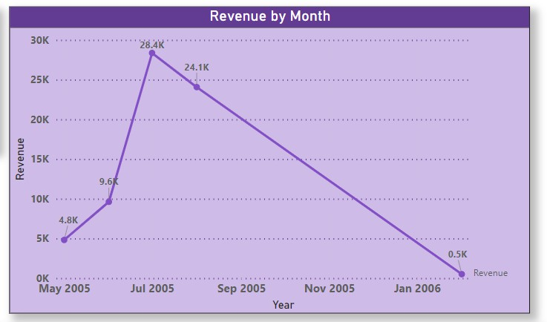
This line chart meticulously maps out the trajectory of sales revenue, offering a comprehensive understanding of financial trends over time. In the year 2005, a distinct upward trend in revenue is clear, peaking in July. This peak
corresponds to the month with the highest number of films rented, suggesting a
strong correlation between film rentals and revenue. This observation underscores the critical role that customer engagement and film selection play in driving revenue.
However, the next month’s reveal notable fluctuations, with a continuous downward
trend from September 2005 to January 2006.

Slide 20
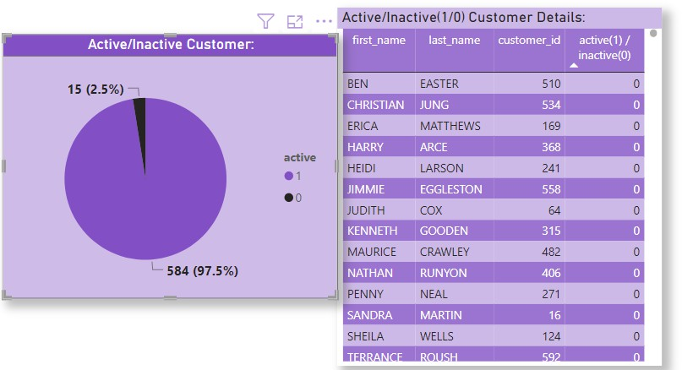
To effectively tackle the issue of inactive customers, it is imperative to employ targeted strategies based on data-driven insights. Analysing the above table, which supplies details about these inactive customers, can unveil valuable information about their preferences, past interactions, and reasons for inactivity. This data-driven approach can inform personalized campaigns and special discount offers aimed at rekindling their engagement.
The pie chart presents a clear division of customer status, with a substantial 97% stands for active customers and a noticeable 2.5% falling into the inactive category. This distribution underscores the importance of customer retention and re-engagement strategies. While the majority stays active, the presence of inactive customers is a significant opportunity for improvement. And a table chart along with it shows details of Active/Inactive customers.

Slide 21
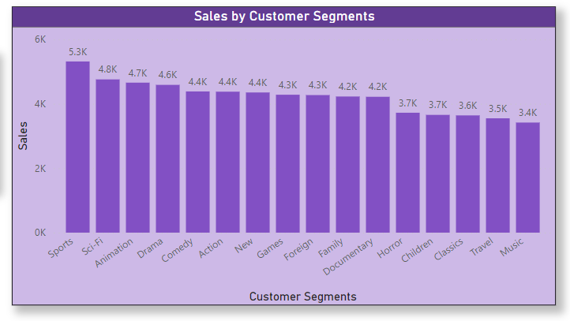
In the absence of predefined customer segments such as age or income in the dataset, I have used film categories as surrogate customer segments to gauge their
impact on sales. The resulting chart effectively visualizes the contribution of each film category to total sales.
Remarkably, the chart portrays the "Sport" segment as the dominant revenue generator, significantly outpacing all other categories, followed by “Sc-fi,”
“Animation” & “Drama,” while "Music" appears as the lowest contributor. This insight emphasizes the critical nature of focusing marketing efforts and strategies on these top-performing segments to both support and enhance revenue growth. The chart also underscores the need to employ data-driven strategies to harness the potential of these high-performing segments. It is imperative for rental stores to analyse and understand the customer preferences within each category, tailoring their offerings and promotional efforts accordingly.

Slide 22
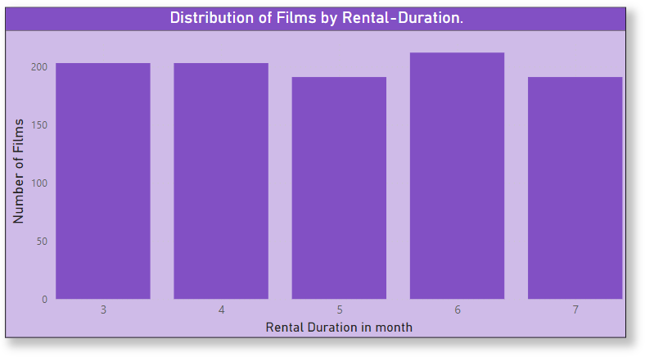
The chart offers a concise and insightful overview of the distribution of films
by rental duration. It becomes clear that rental durations falling within the third
(march)–seventh (July) range are the most prevalent among viewers. This distribution mirrors the typical viewing habits of customers, where they opt for rentals that cater to their short to medium-term entertainment needs.
The data also highlights a noteworthy pattern - the 6th month appears as the peak month for viewers. This signifies a significant spike in rentals during this period, aligning with a specific season or customer behaviour pattern. Understanding this peak month presents an opportunity for rental stores to tailor their marketing efforts, special promotions, and film selections to capitalize on this surge in customer
engagement.

Slide 23
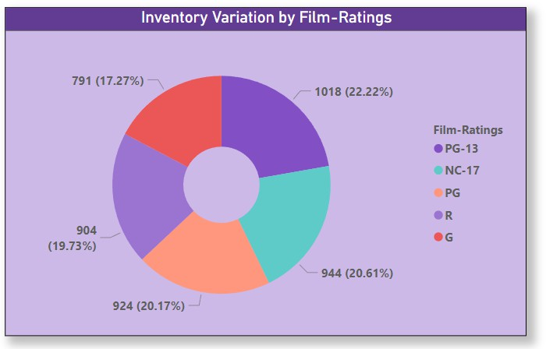
This insight is valuable, as it can guide inventory management decisions and content acquisition strategies. It underscores the potential opportunity for rental stores to expand their selection of G-rated
(general audience) films to cater to families and viewers with young children, tapping into a demographic that may underserved. The interplay between film inventory and viewer preferences has profound implications for rental store operations. By
perfecting the inventory based on rating categories, rental businesses can enhance customer engagement and drive revenue growth. It is essential for rental stores to recognize these nuances in customer preferences and strategically manage their inventory to meet diverse demands.

Slide 24
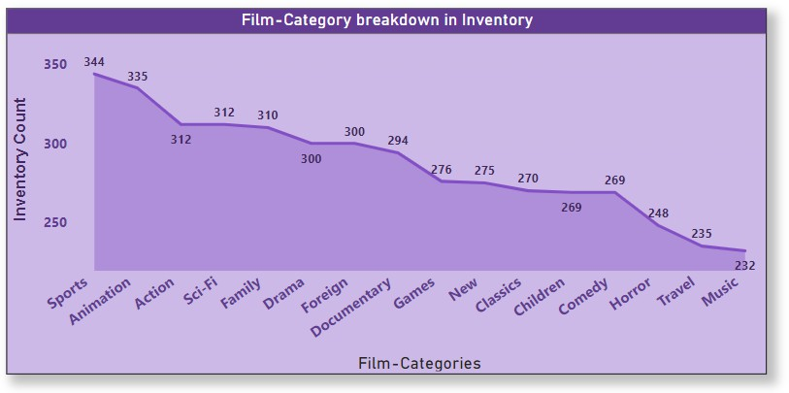
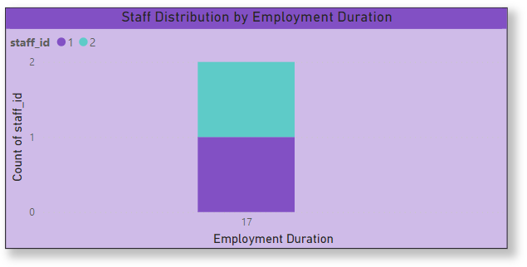
The chart is a showcase of diversity in film genres, offering the flexibility to adapt to the ever-evolving demands of viewers. By keeping a wide range of genres, the rental store can ensure the availability of customer-favourite categories. Furthermore, it serves as a strategic guide for perfecting content selection, offering data-driven insights that can influence content acquisition decisions.
The column chart serves as a visual representation of the distribution of staff by their employment duration, shedding light on a specific aspect of the rental store's
workforce. However, a notable aspect is that in the dataset, there are only two staff members, and their calculated employment duration appears to be the same at 17 years.

Slide 25
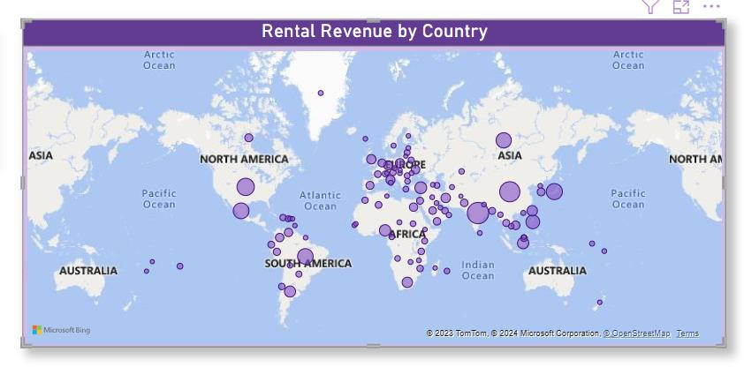
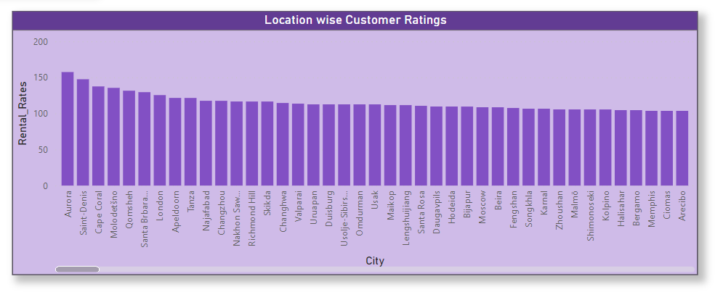
The data presented in this chart underscores the importance of tailoring business strategies to specific regions, considering the unique customer preferences, market dynamics, and economic conditions in each country. It aligns perfectly with the project's aim of enhancing revenue and maximizing the rental store's performance in different global markets.
In summary, the insights gained from this chart not only supply a snapshot of rental revenue variations by country but also offer a strategic compass for rental businesses to explore untapped potentials in high-revenue countries and broaden their global footprint in the competitive movie rental market.

Slide 26
EDA Problem
Statements

Slide 27
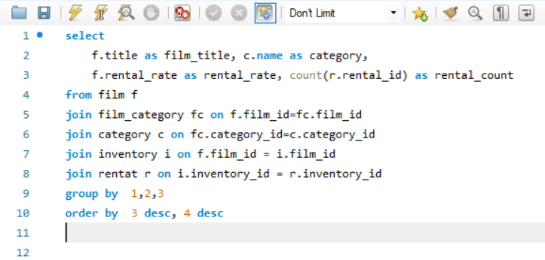
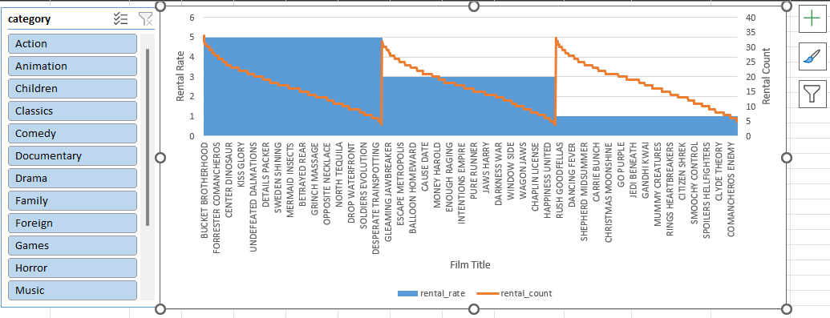
This observation is of paramount significance for rental stores. By analysing films with the highest rental rates and demand, rental businesses can
strategically prioritize their inventory and marketing endeavours. This entails ensuring that popular titles, particularly those that combine affordability with high demand, are readily available to cater to customer preferences.

Slide 28
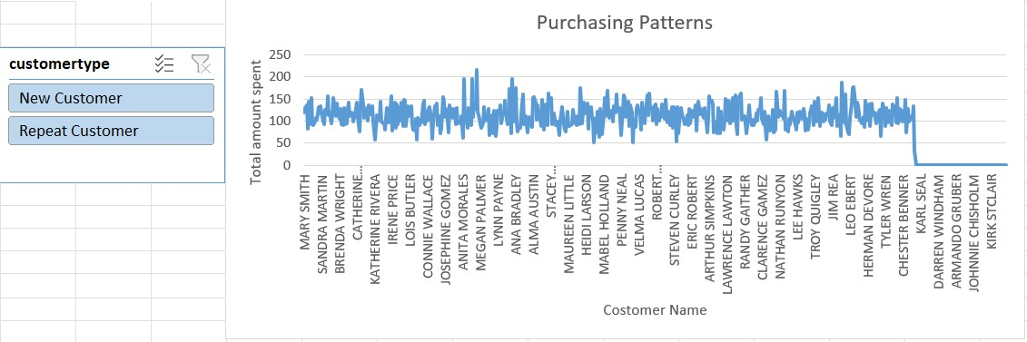
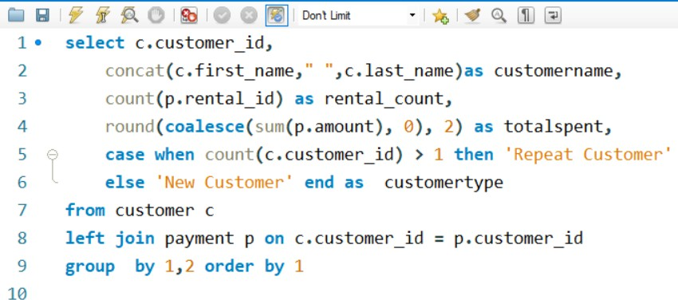
It's essential to recognize that the portion of new customers not making purchases represents untapped potential. This untapped customer segment can be a goldmine if approached strategically. Targeted marketing efforts, such as welcome discounts or personalized recommendations, can be devised to convert these prospects into paying customers, thereby increasing revenue

Slide 29
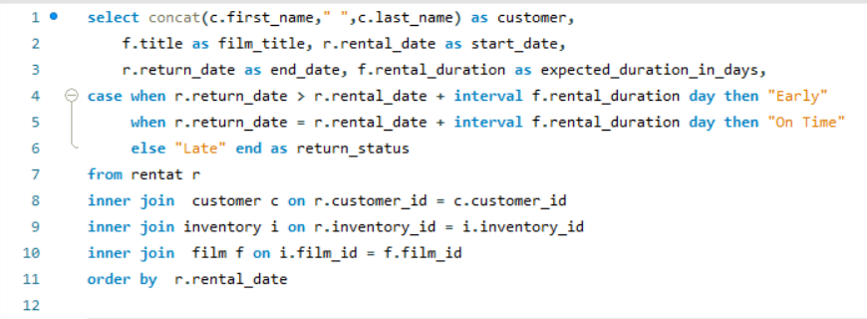
Insights:
The chart vividly illustrates a compelling trend – films with higher rental rates tend to be in high demand. This correlation signifies that customers are not only willing to pay more for films but are also actively seeking out movies that they find highly appealing and entertaining. As a prime example, the movie "BUCKET BROTHERHOOD" exhibits both higher rental rates and remarkable demand, highlighting its strong desirability among viewers.
This observation is of paramount significance for rental stores. By analysing films with the highest rental rates and demand, rental businesses can strategically prioritize their inventory and marketing endeavours. This entails ensuring that popular titles, particularly those that combine affordability with high demand, are readily available to cater to customer preferences.

Slide 30
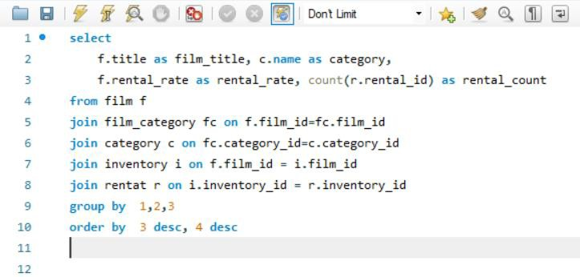
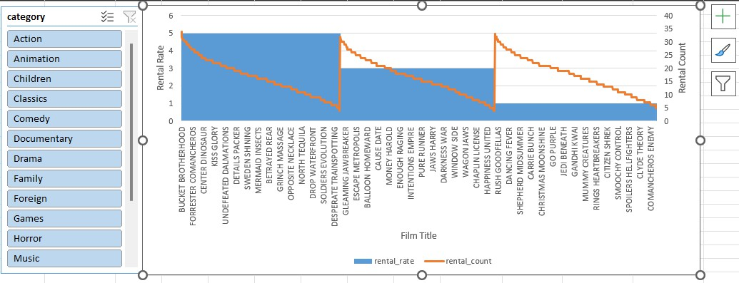
The chart vividly illustrates a compelling trend – films with higher rental rates tend to be in high demand. This correlation signifies that customers are not only willing to pay more for films but are also actively seeking out movies that they find highly appealing and entertaining. As a prime example, the movie "BUCKET BROTHERHOOD" exhibits both higher rental rates and remarkable demand, highlighting its strong desirability among viewers.

Slide 31
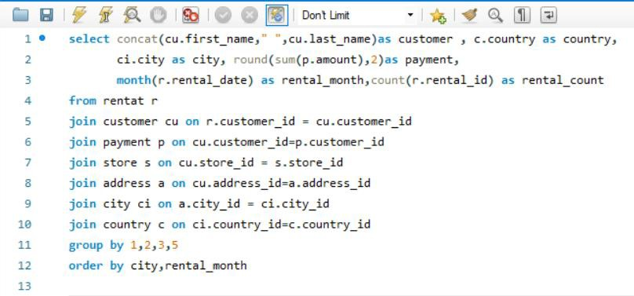
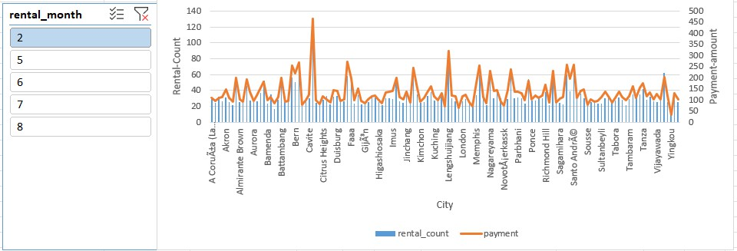
The analysis of seasonal trends in customer behavior across diverse locations unveils a captivating narrative - specific film categories witness a surge in demand during distinct seasons. This chart elegantly illustrates these fluctuations, with an unmistakable pattern emerging. Notably, more customers engage in film-watching activities during the sixth month (July) and the eighth month (October), marking these periods as peak seasons for movie rentals. Conversely, customer engagement tends to wane during the second month (February), signaling lower viewership.

Slide 32
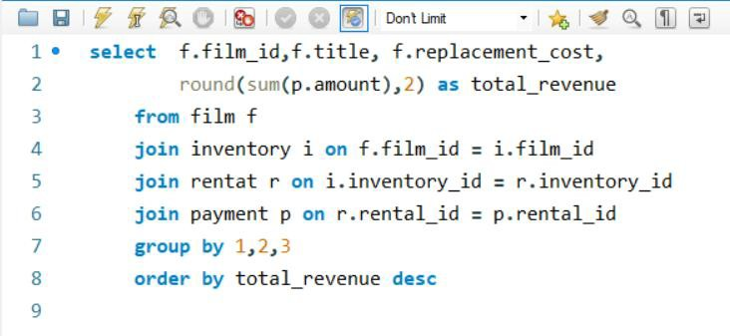
For keeping financial stability, the rental store faces the essential task of striking a delicate balance. It involves offering a diverse film selection to meet customer preferences while simultaneously managing replacement costs effectively. Achieving this balance needs vigilant monitoring of damage rates, setting proper replacement fees that neither deter customers nor lead to losses, and implementing preventive measures to curtail film losses.

Slide 33
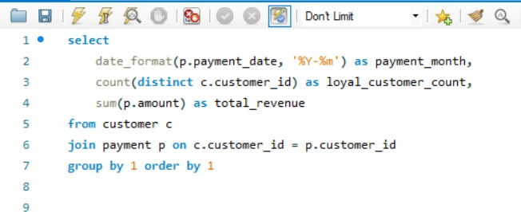
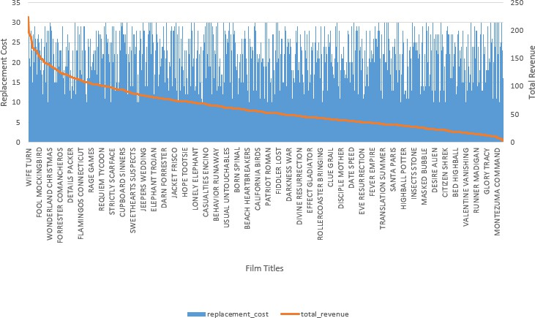
The chart before us presents a revealing narrative about the interplay
between replacement costs and film revenue. Notably, the film "WIFE TURN" stands out with the highest replacement cost and, intriguingly, it generates
the highest revenue. This observation underscores the direct impact of
replacement costs on the profitability of the rental store. Higher replacement costs are a critical factor in the financial equation, particularly when films are often damaged or lost by customers.
payment month | Loyal customer count | total revenue
2005-05 | 455 | 4239.83
2005-06 | 512 | 8438.63
2005-07 | 521 | 24618.63
2005-08 | 520 | 21092.2
2006-02 | 134 | 442.44

Slide 34
THANK YOU🎯

